Slide 1
Kubernetes(k8s)
DevOps Training
Shriniwas Mujumdar
Yogendra Kumar Vyas
Sagar Joshi

Slide 2

Docker Logo

Slide 3
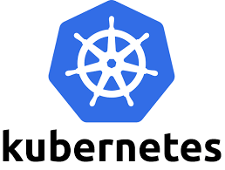
Kubernetes - Logo

Slide 4
Kubernetes - History
Once upon a time…..in Google….Borg, Omega…k8s
Open Source from Google
Supported by CNCF (Cloud Native Computing Foundation)
Written in Go/Golang Language. Code on GitHub.
Kubernetes Meaning
Greek Word
(“koo-burr-NET-eez”) is the no-doubt-mangled conventional pronunciation of a Greek word, κυβερνήτης, meaning “helmsman” or “pilot.”
k8s (kubernetes)

Slide 5
Kubernetes
Docker
Single container –start/stop/delete/pull/push
Kubernetes
Scaling
Healing
Updating

Slide 6
Kubernetes - Orchestrator
Orchestrator for Microservices applications.
Real Word Analogy (just for understanding the concept)
Music Conductor - Coordinates Musicians to create a symphony
Sports Coach – Football/Hockey

Slide 7
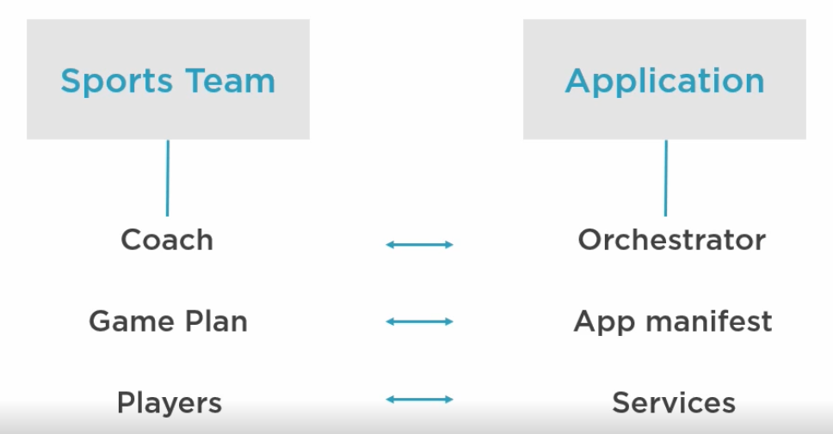
Kubernetes - Orchestrator

Slide 8
Hands on
https://labs.play-with-docker.com/
Docker Desktop
https://labs.play-with-k8s.com/
Please use AWS VMs for Kubernetes, we need to make 3 node cluster

Slide 9
Docker and Kubernetes Events
DockerCon
https://www.docker.com/dockercon/
KubeCon

Slide 10
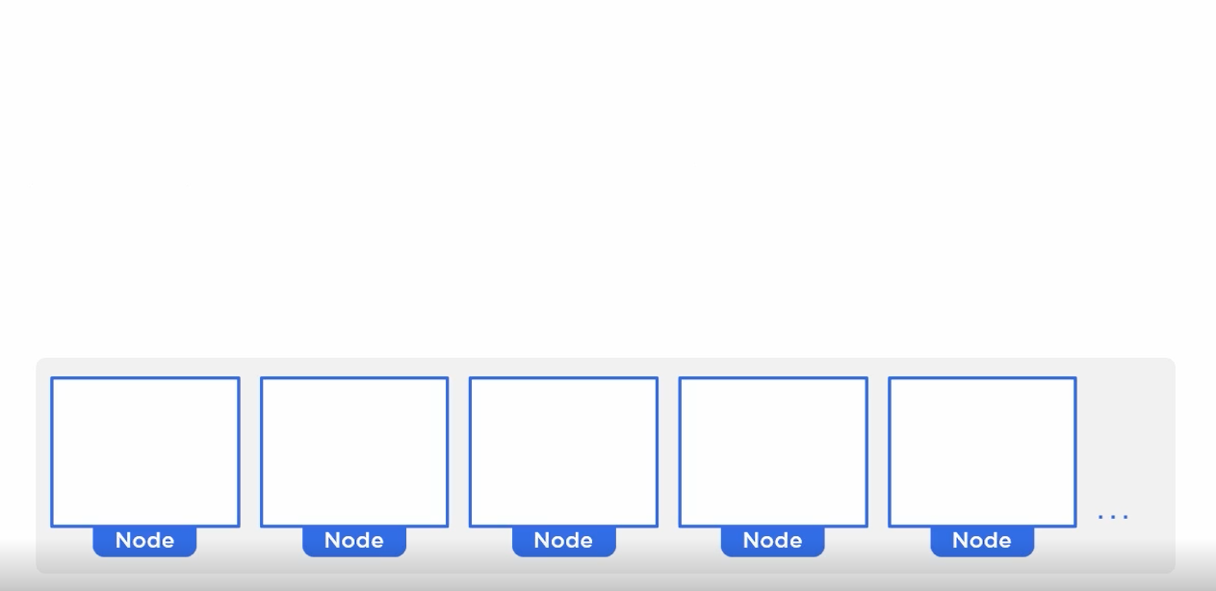
Kubernetes in Action

Slide 11
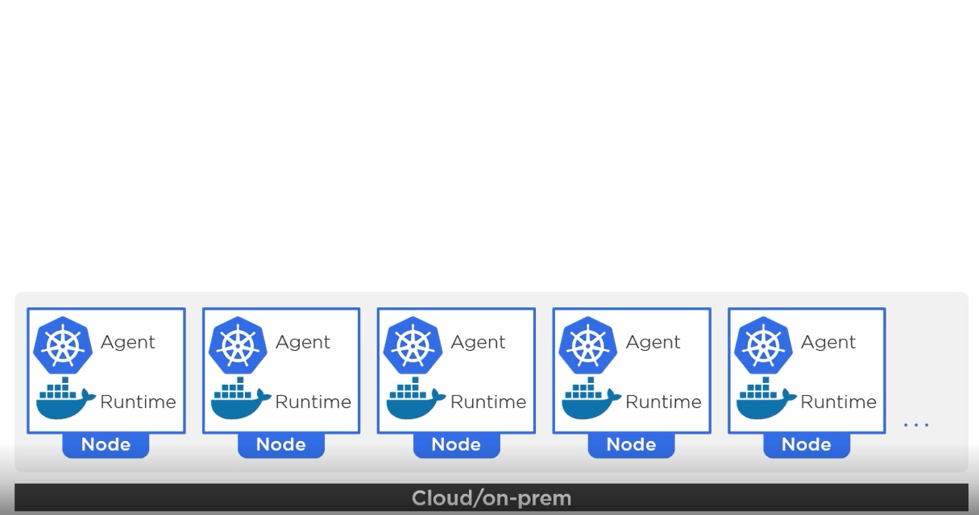
Kubernetes in Action

Slide 12
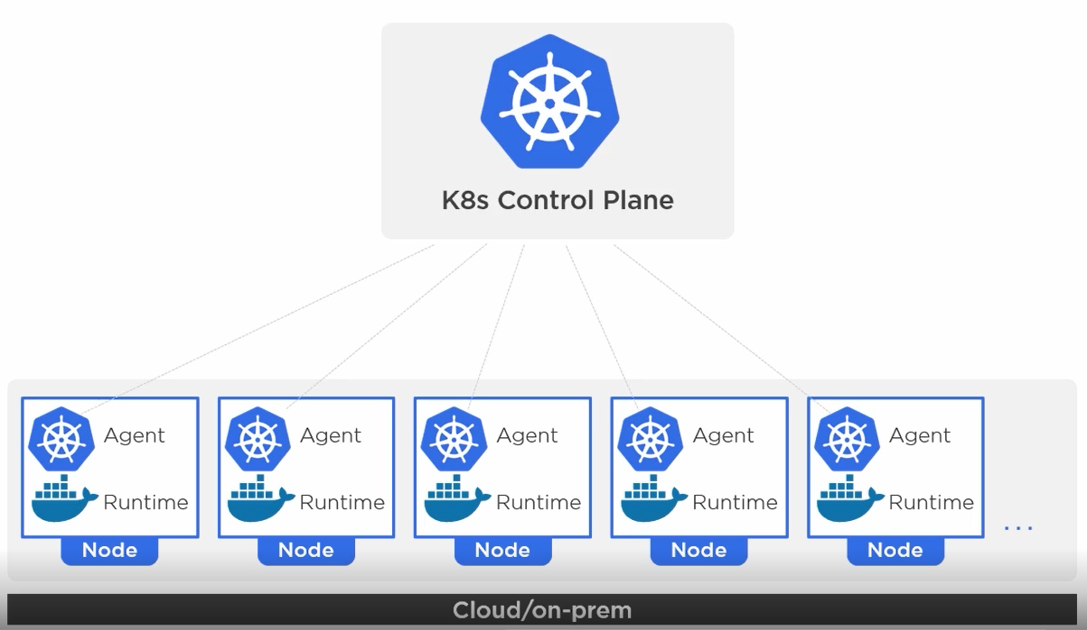
Kubernetes in Action

Slide 13
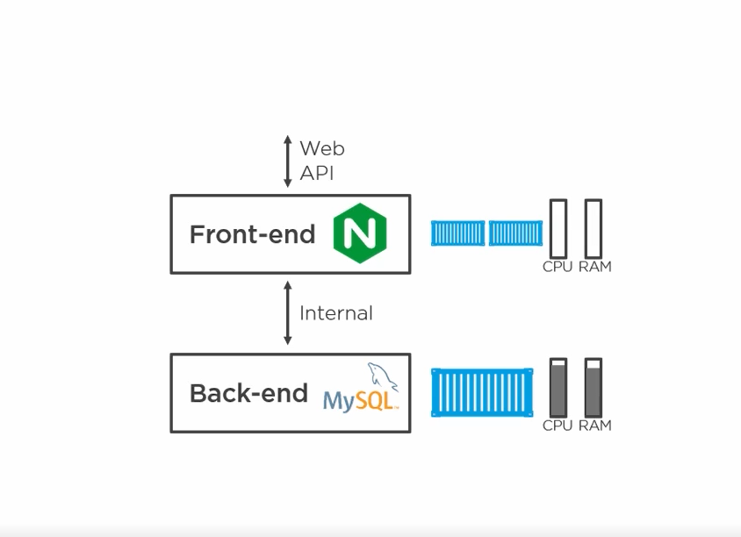
Kubernetes in Action

Slide 14
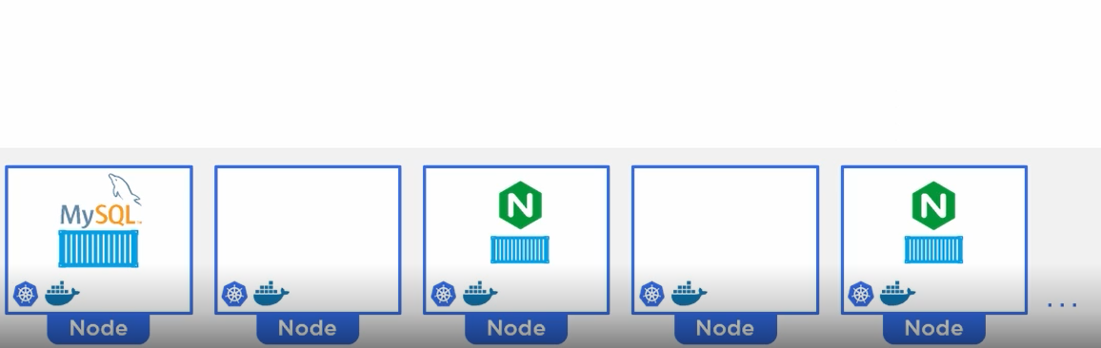
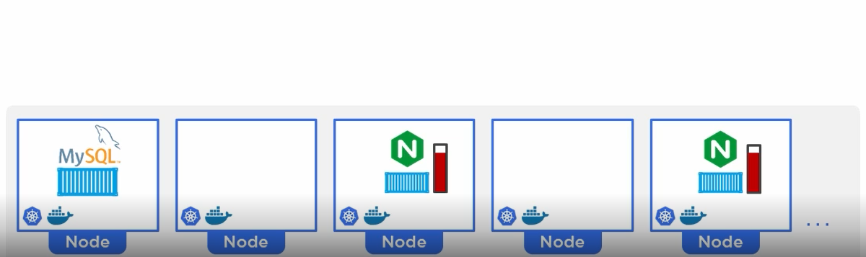
Kubernetes in Action – Desired=Actual

Slide 15
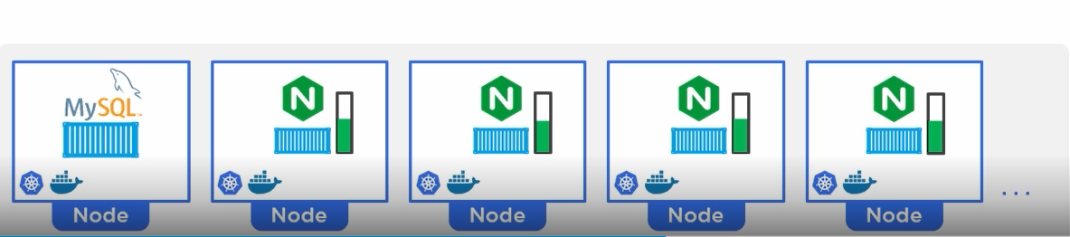
Kubernetes in Action – Actual > Desired

Slide 16
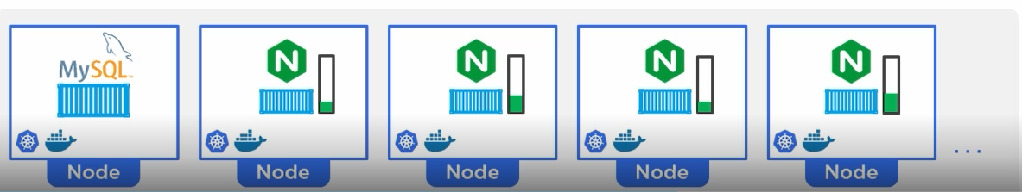
Kubernetes in Action – Load Decreases

Slide 17
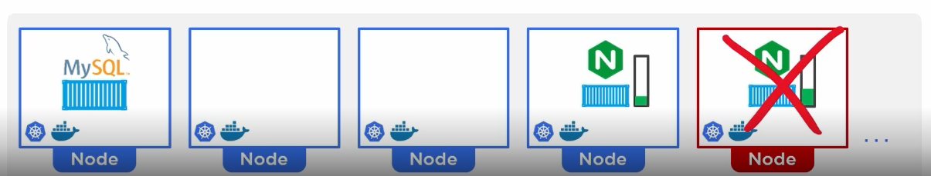
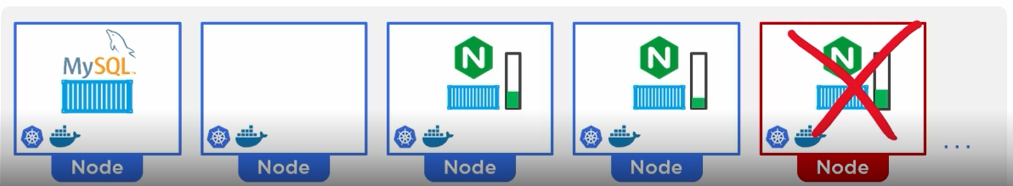
Kubernetes in Action – Node goes down

Slide 18
NAT & Subnet

Slide 19
Kubernetes
Alpha
Early Code
Uncertain Features
Not for Production
Beta
Some details may change
GA (General Availability)
Production Ready
Stable from Code and features aspect.

Slide 20
Kubernetes on Cloud
AWS
Elastic Kubernetes Service (EKS)
Azure
Azure Kubernetes Service (AKS)
Google Cloud
Google Kubernetes Engine (GKE)

Slide 21
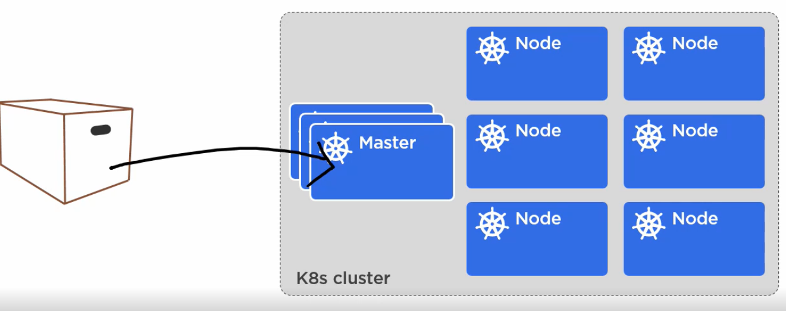
Kubernetes Architecture and Components

Slide 22
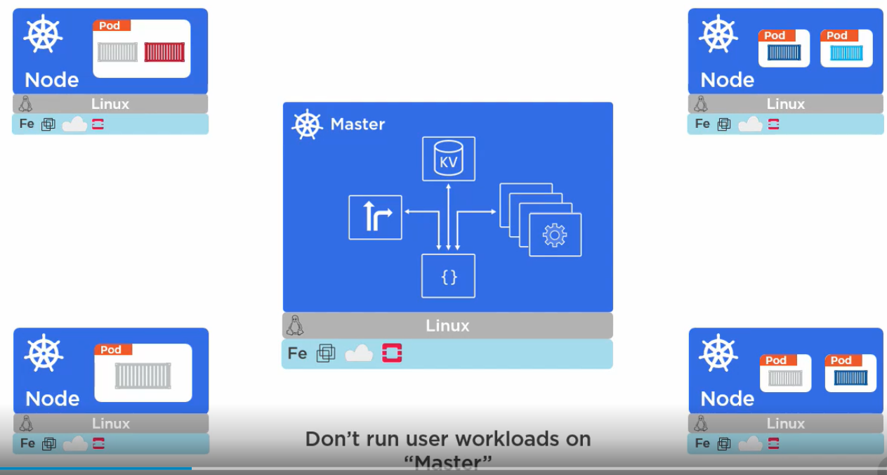
Kubernetes Cluster – Master and Nodes (Minions)

Slide 23
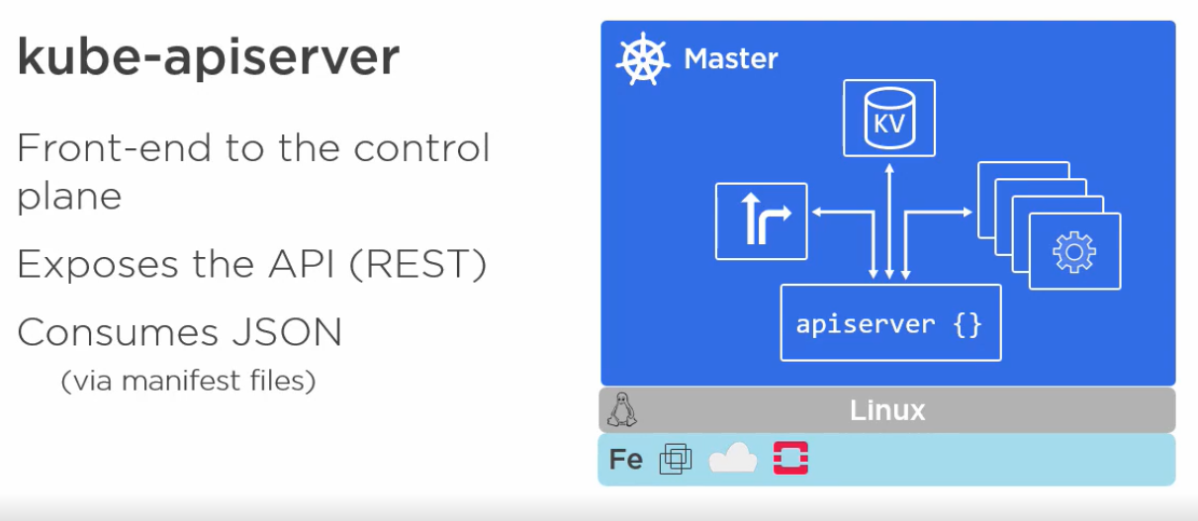
Kubernetes Master – What is inside?

Slide 24
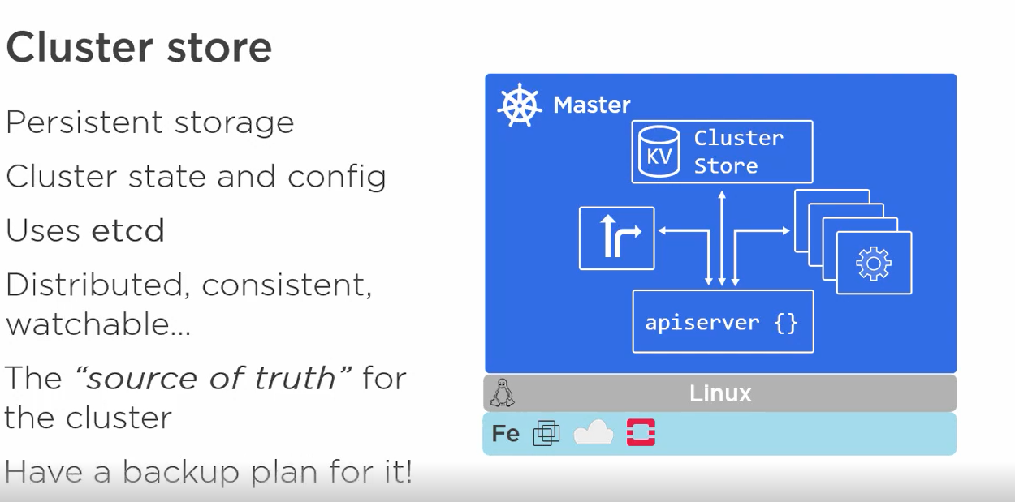
Kubernetes Master – What is inside?

Slide 25
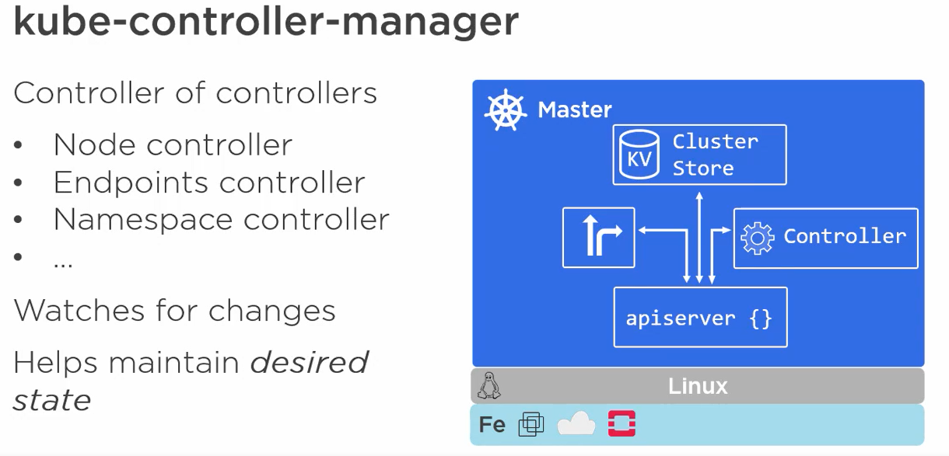
Kubernetes Master – What is inside?

Slide 26
Kubernetes Master – What is inside?

Slide 27
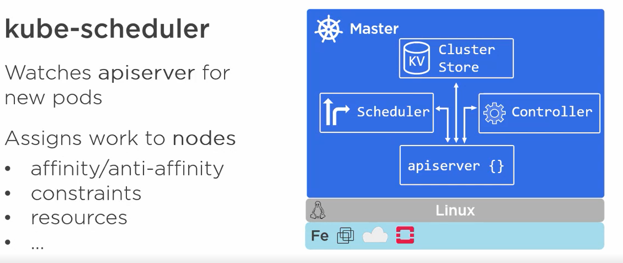
Kubernetes Master – What is inside?

Slide 28
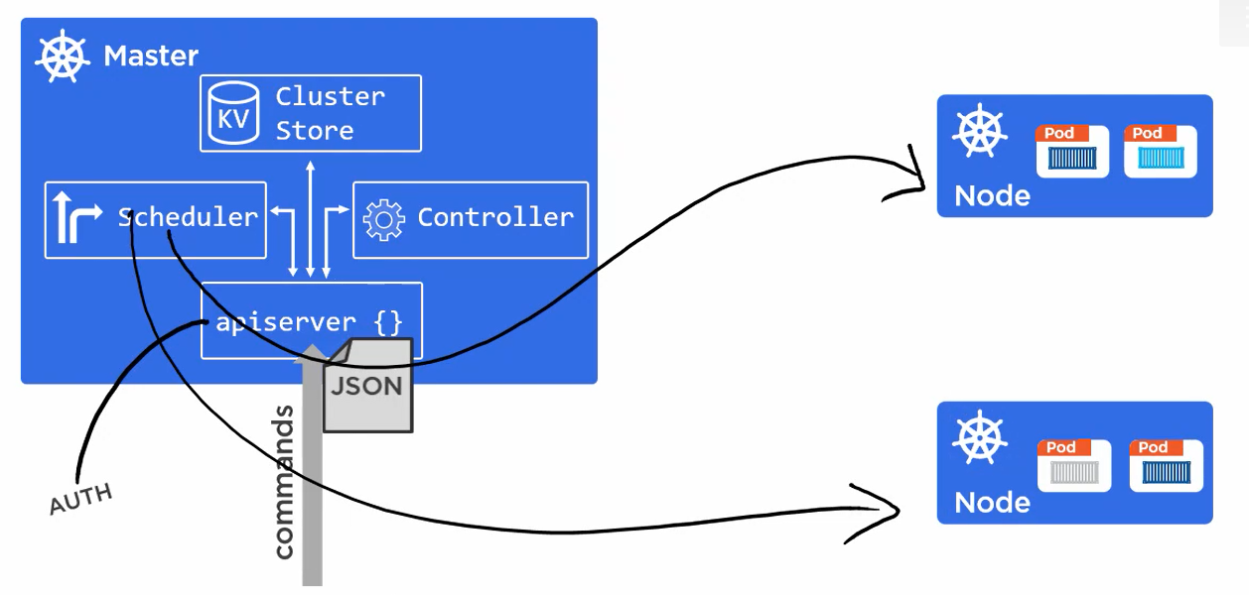
Kubernetes Master

Slide 29
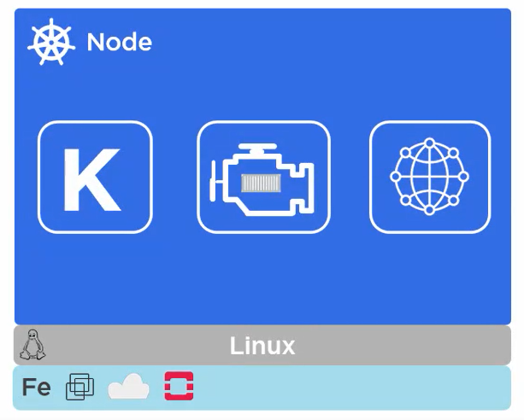
Nodes a.k.a Minions – The Kubernetes Workers

Slide 30
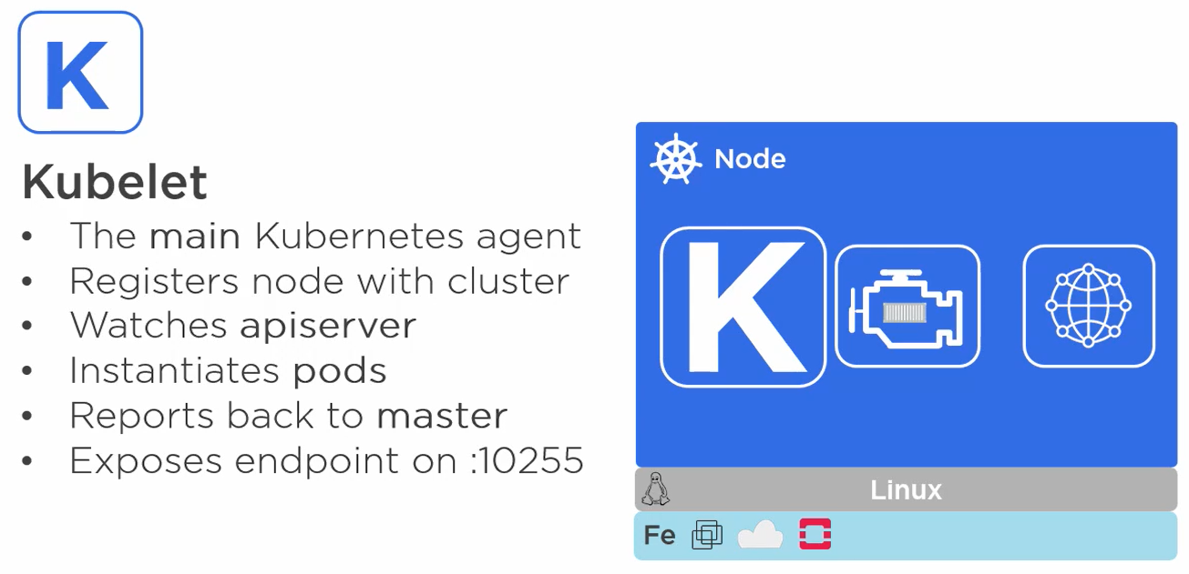
Inside Node - Kubelet

Slide 31
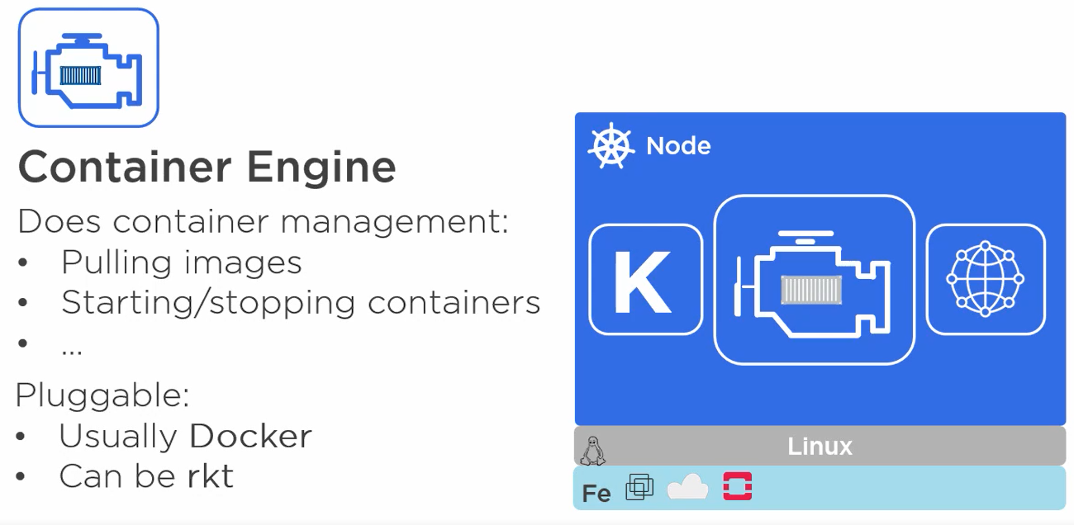
Inside Node – Container Engine

Slide 32
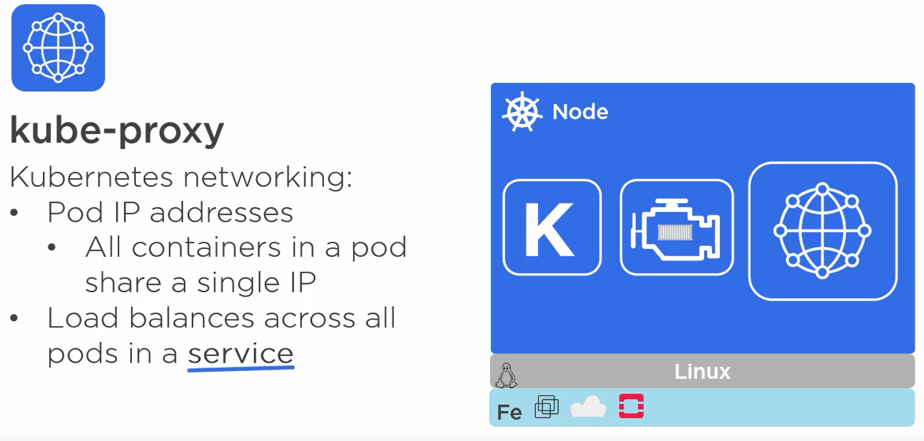
Inside Node – kube-proxy

Slide 33
Exercise
Recap

Slide 34
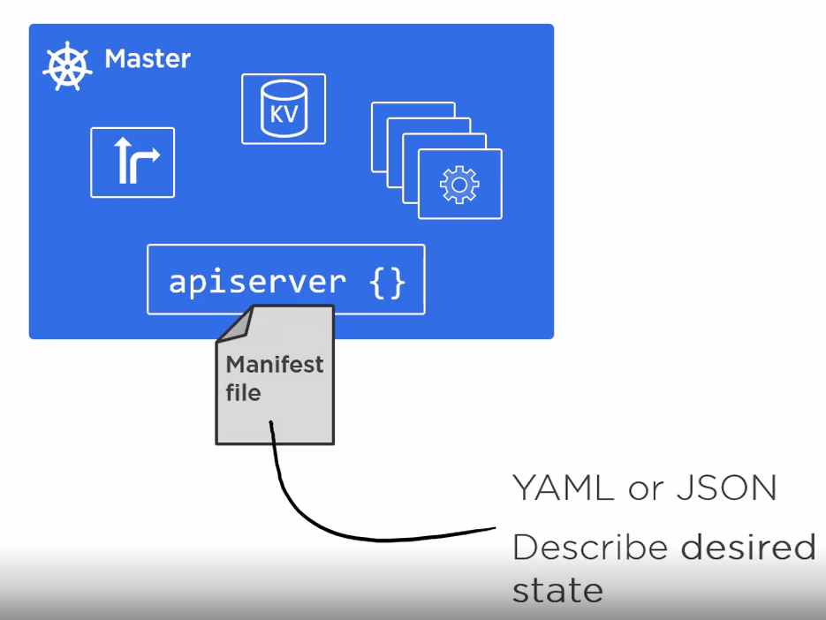
Declarative Model and Desired State

Slide 35
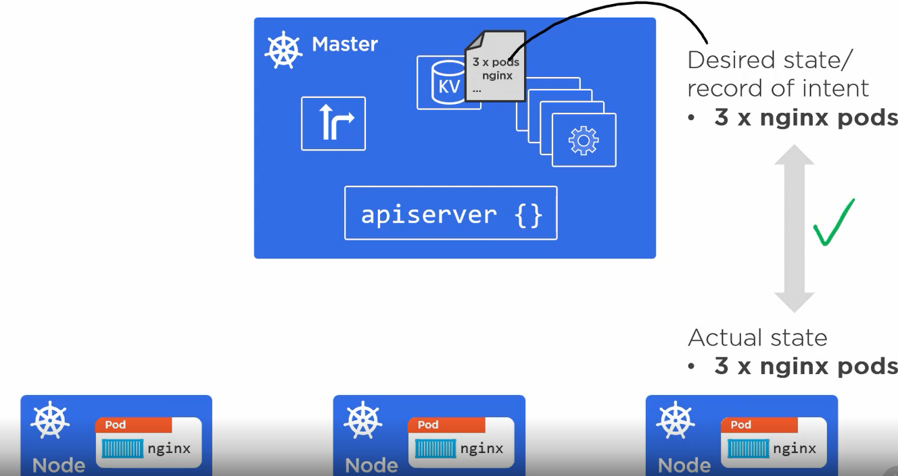
Declarative Model and Desired State All is Well

Slide 36
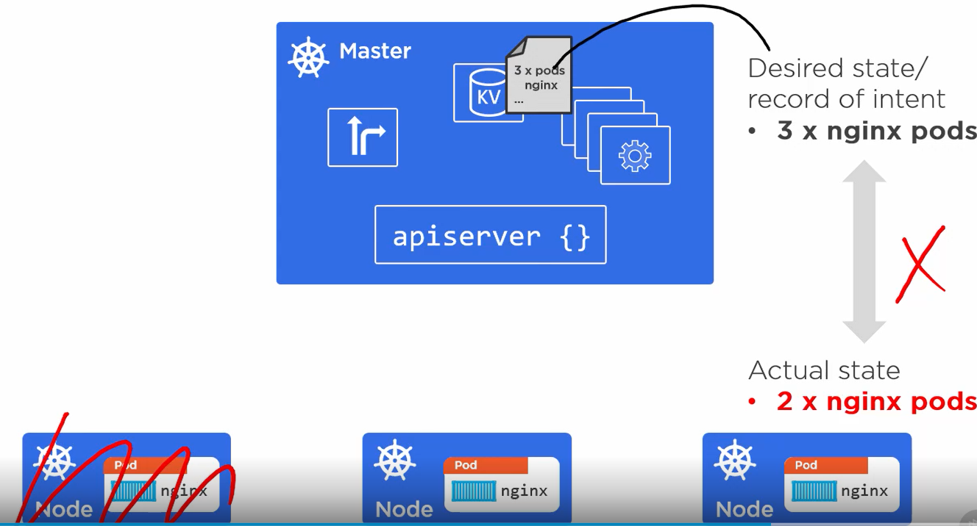
Declarative Model and Desired State All is NOT Well

Slide 37
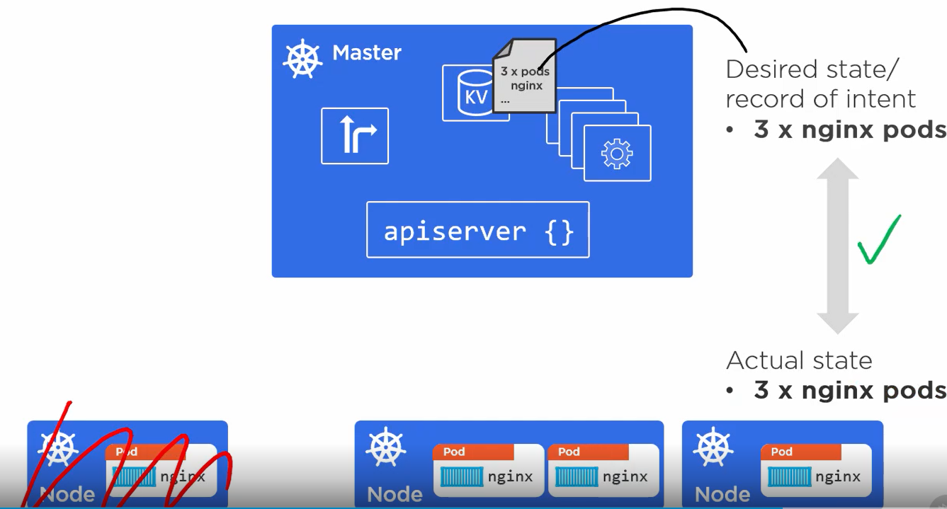
Declarative Model and Desired State All is Well again

Slide 38
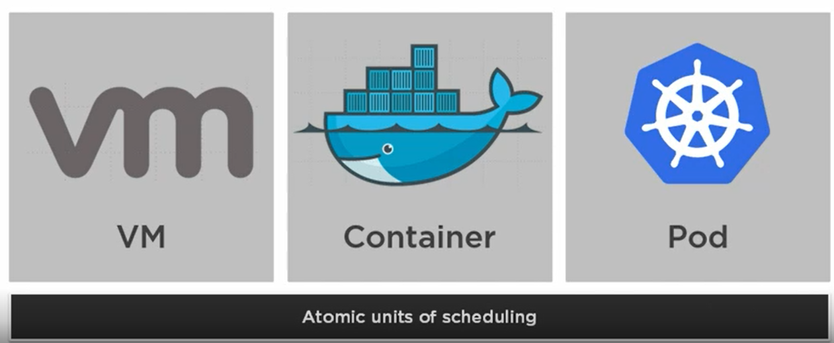
Pods

Slide 39
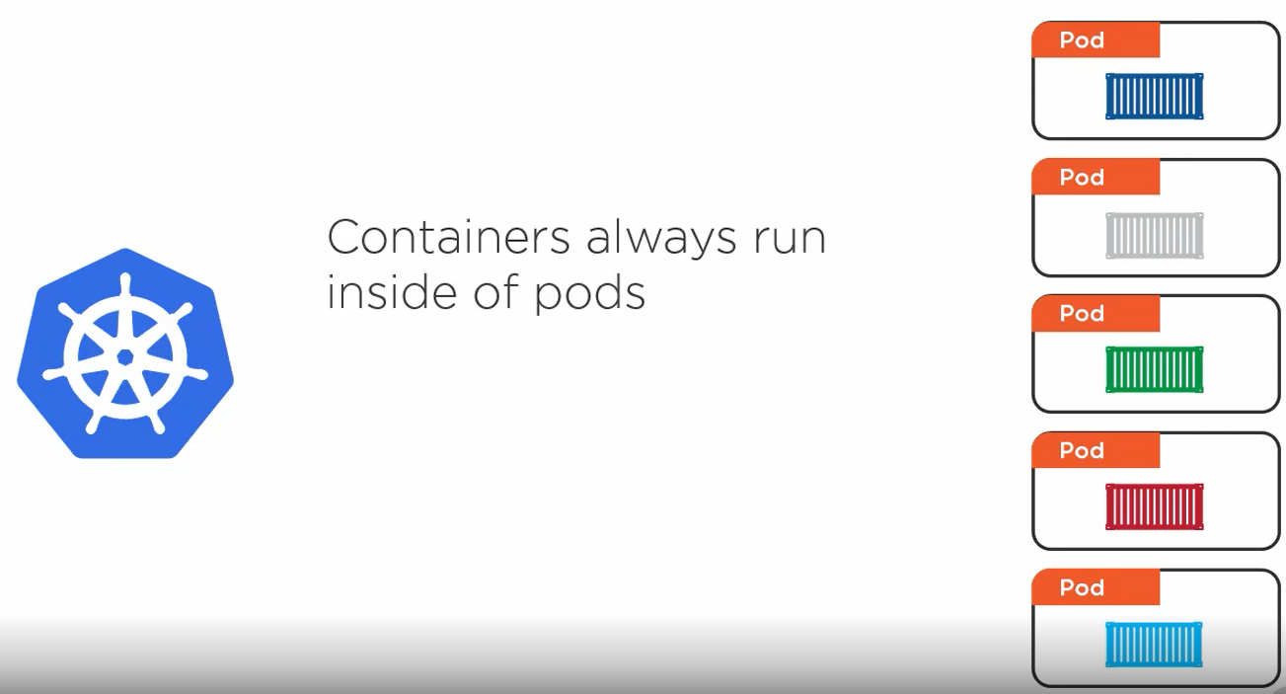
Pods

Slide 40
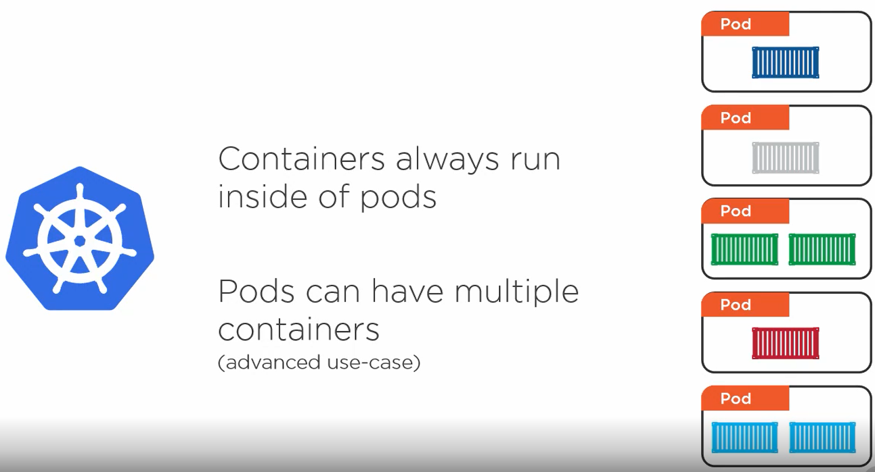
Pods

Slide 41
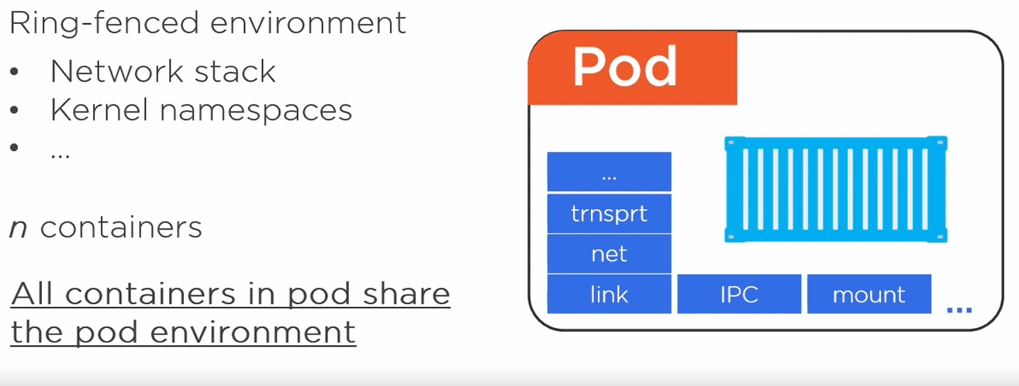
Pod

Slide 42
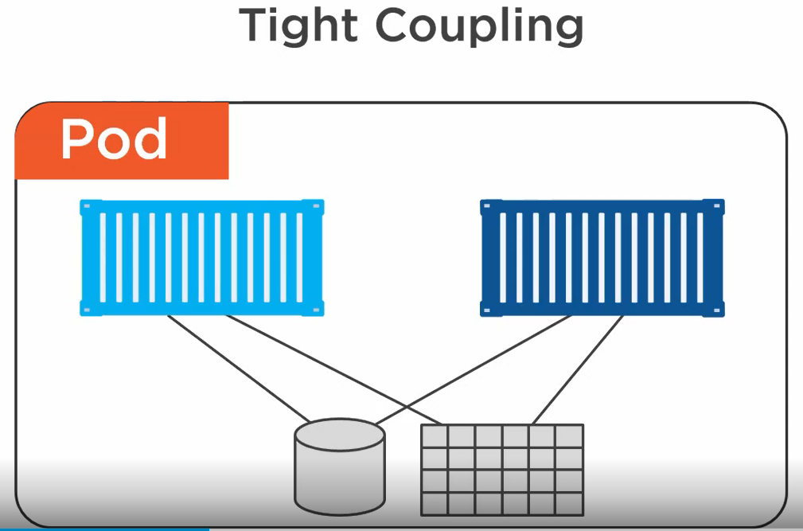
Pods - Tight Coupling

Slide 43
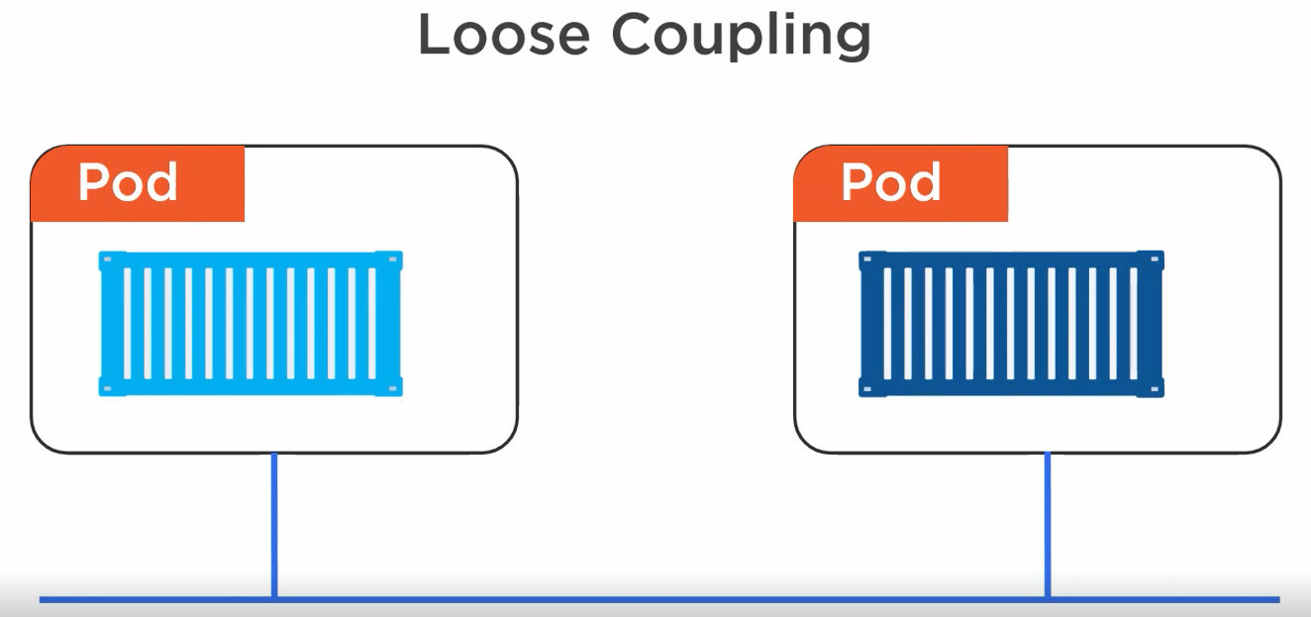
Pods – Loose Coupling

Slide 44
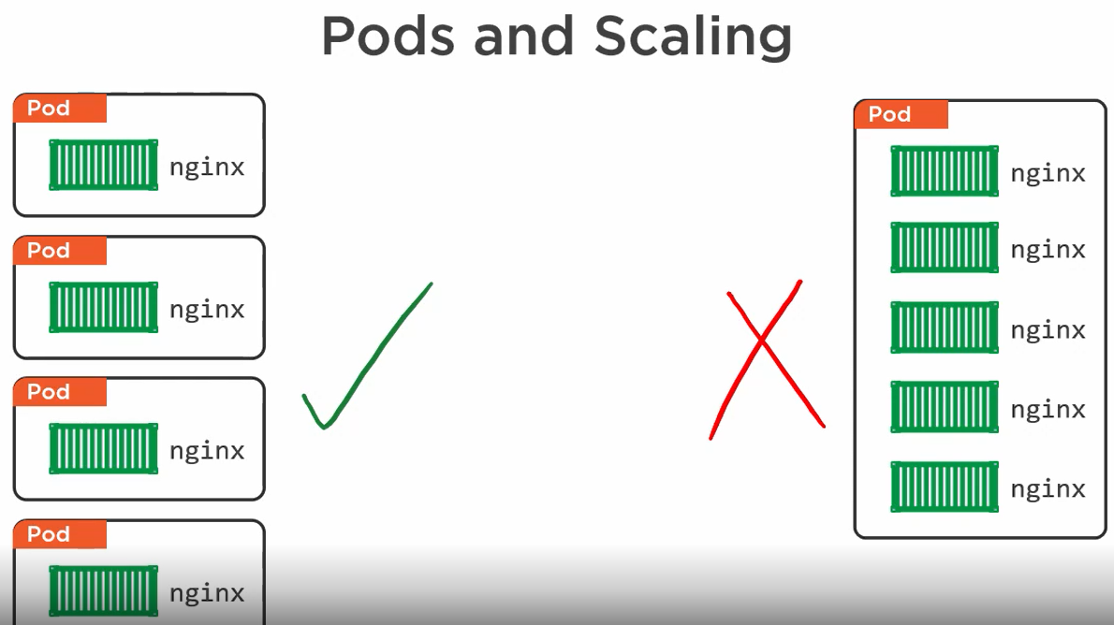
Pods – Basic unit of Scaling

Slide 45
Pods are Atomic
Multi- Container Pods
Web Server (Main Container)
Log Scraper (Sidecar Container)
A single Pod will exist on a single node
Scaling from 1 pod to 2 pods
For k8s - Add one more pod
In a new pod -Both containers should be up and running to complete scaling

Slide 46
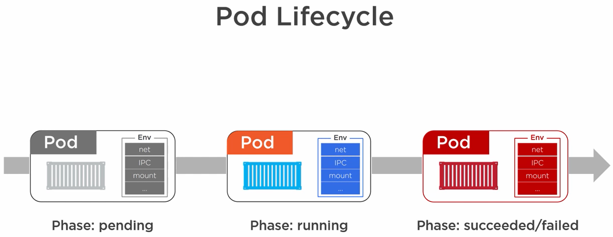
Pods Lifecycle

Slide 47
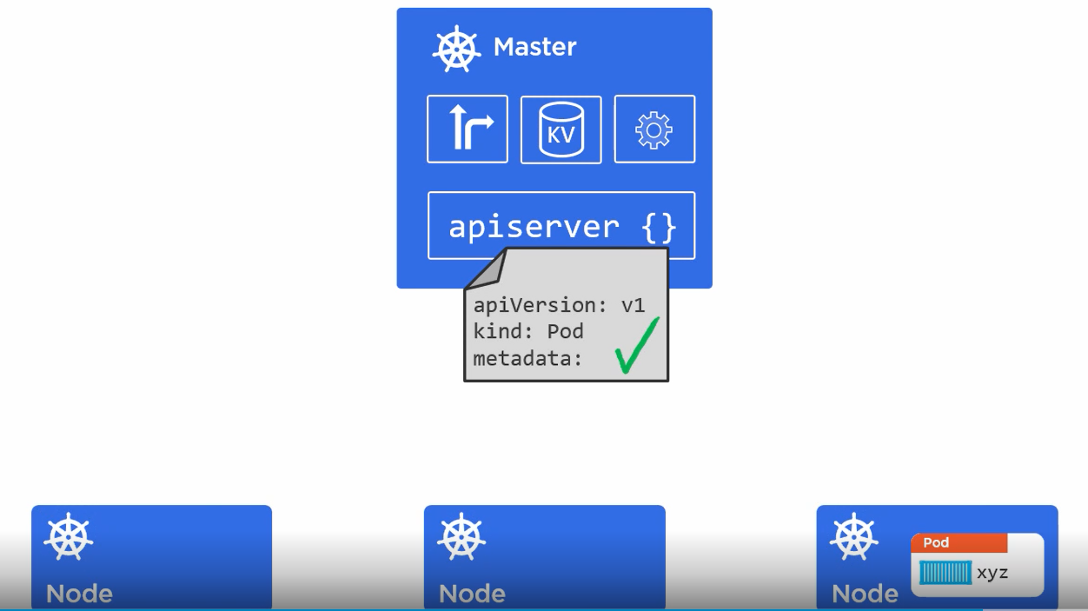
Deploying Pods - Pod Manifest

Slide 48
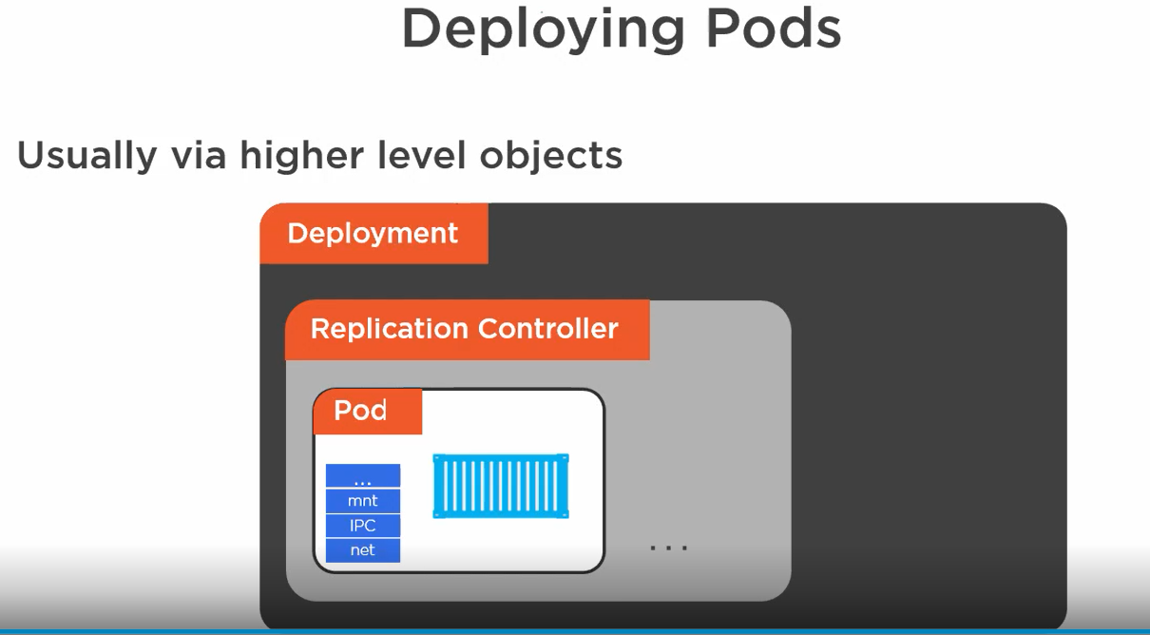
Deploying Pods -

Slide 49
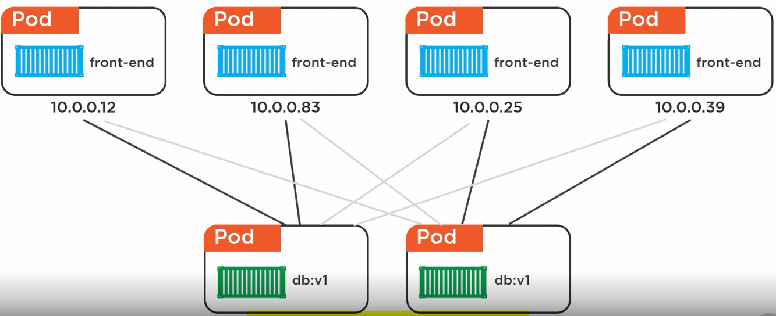
Services

Slide 50
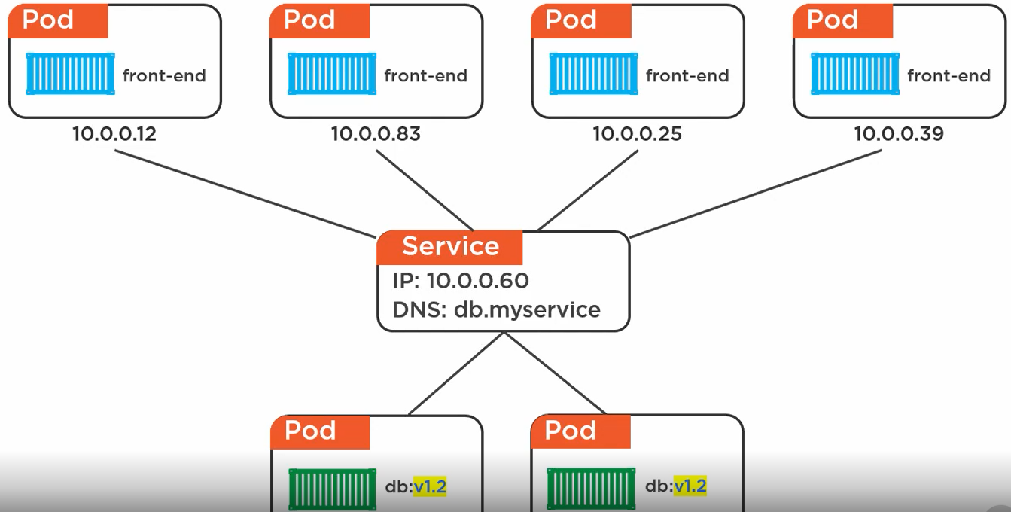
Services – Constant IP and Load Balancing

Slide 51
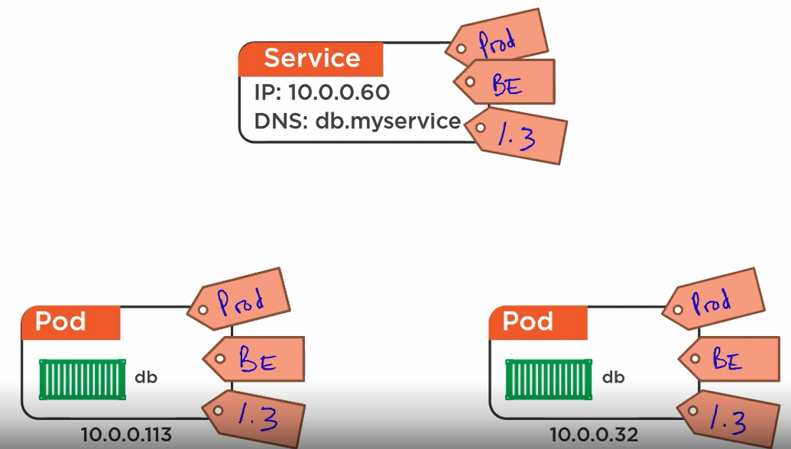
Service – Labels – Load Balancing

Slide 52
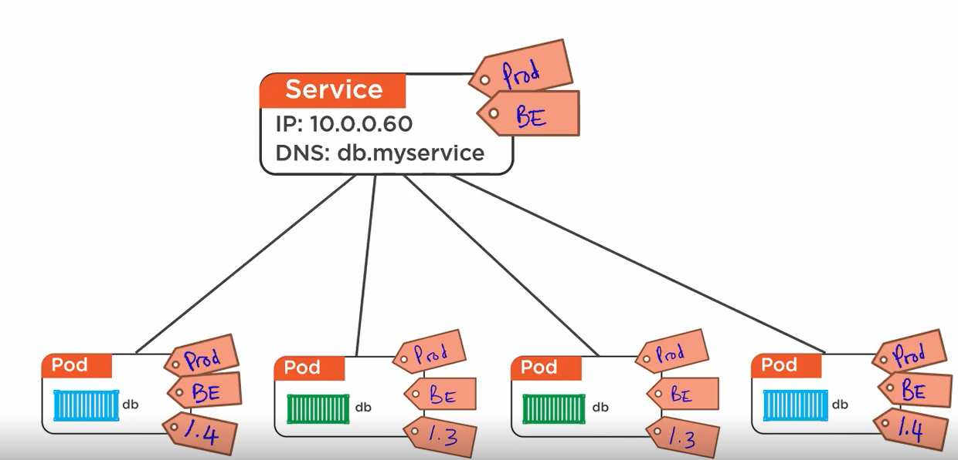
Service – Labels – Load Balancing

Slide 53
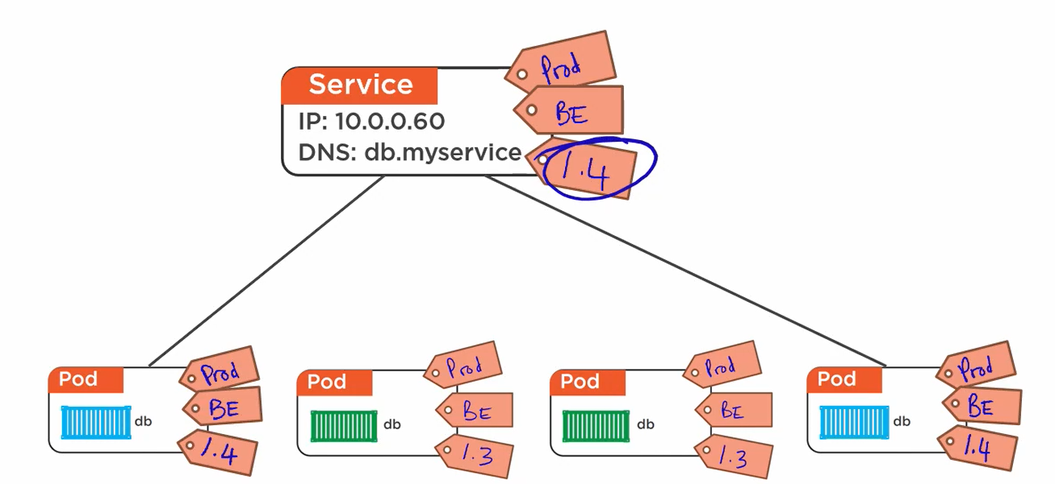
Service – Labels – Load Balancing

Slide 54
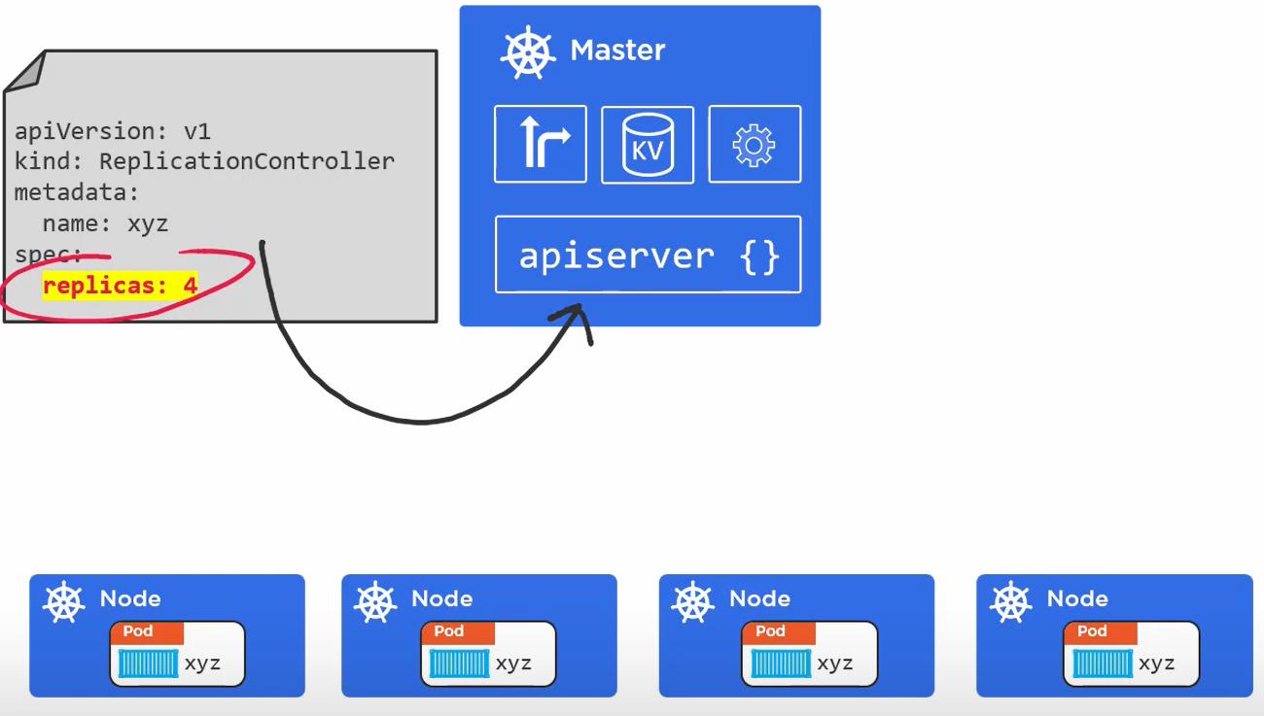
Deployments

Slide 55
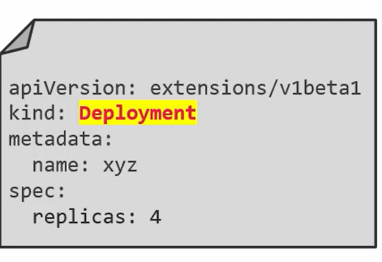
Deployments
REST Objects
Deployed via YAML/JSON manifests
Deployed via apiserver
Simple Rolling updates/rollbacks
Replacing Replication Controller
Replica Sets; next version of Replication Controller

Slide 56
Exercise
Recap

Slide 57
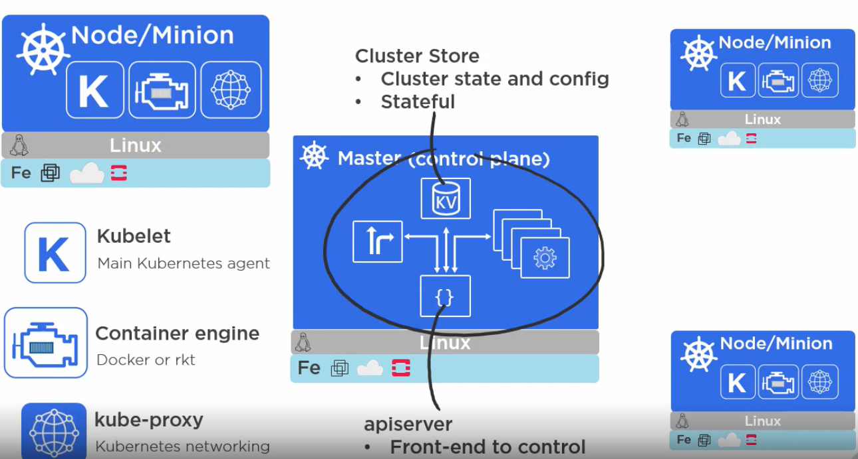
Recap

Slide 58
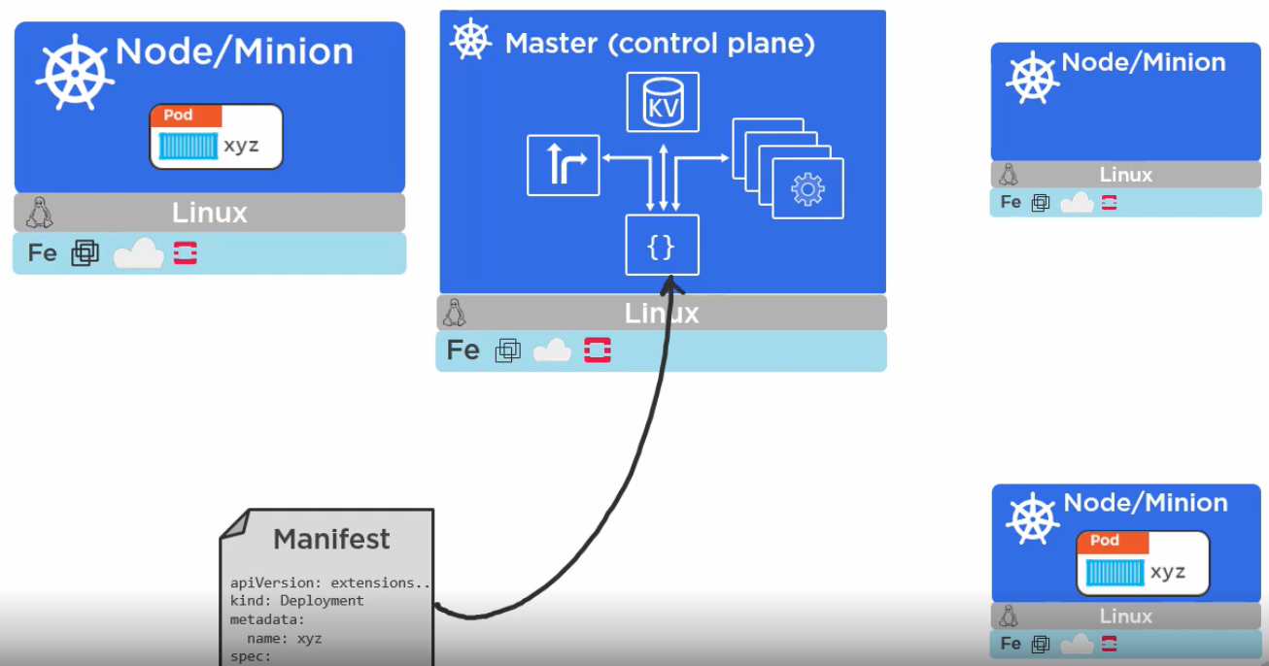
Recap

Slide 59
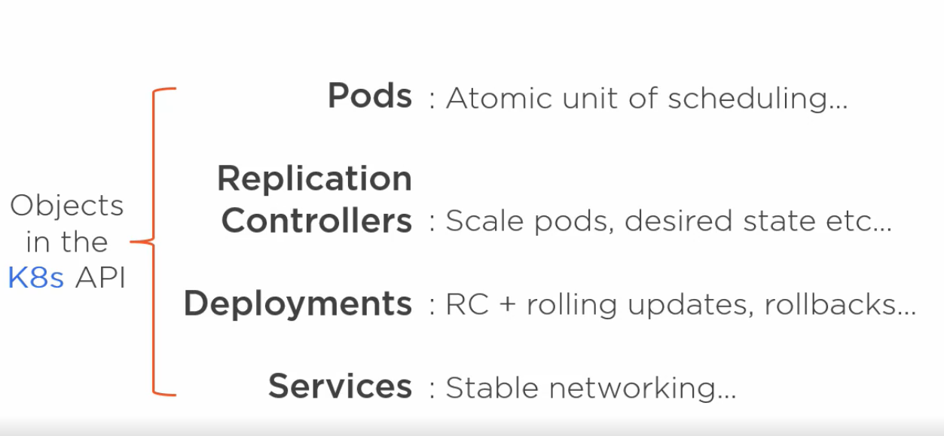
Recap

Slide 60
Installing Kubernetes
MiniKube
Install on Mac/Windows
1 Master and 1 Node set up
1 Master and Multi Node or Multi Master (HA) and Multi node is not possible.
Google Kontainer Engine (GKE)
Azure Kubernetes Service (AKS)
AWS (EKS- Elastic Container Service for Kubernetes)

Slide 61
Installing Kubernetes
Manual Install
Share Installation Steps document.
Follow the steps first, execute later

Slide 62
$kubectl
$kubectl version
$kubectl get nodes
$kubectl describe node <<node name>>

Slide 63
Create Pods – pods1.yml
kind: Pod
apiVersion: v1
metadata:
name: testpod
spec:
containers:
- name: c01
image: ubuntu
command: ["/bin/bash", "-c", "while true;do echo Hello Admin;sleep 5;done"]
restartPolicy: Never

Slide 64
Create Pods – pods1.yml
$kubectl apply –f pods1.yml
Created in default namespace
No “–n” flag is specified
$kubectl get pods
$kubectl describe pod testpod
$kubectl logs -f testpod

Slide 65
Create Pods – pods1.yml
$kubectl get pods –o wide
$kubectl get pods –o yaml
Pod data in YAML format
$kubectl delete pods testpod

Slide 66
Create Pods - pods2.yml
kind: Pod
apiVersion: v1
metadata:
name: testpod2
annotations:
description: our testpod with annotation description
spec:
containers:
- name: c01
image: ubuntu
command: ["/bin/bash", "-c", "while true;do echo Hello Admin;sleep 5;done"]
restartPolicy: Never

Slide 67
Create Pods – pods2.yml
$kubectl apply –f pods2.yml
Created in default namespace
No “–n” flag is specified
$kubectl get pods
$kubectl describe pod testpod2
$kubectl logs -f testpod2
$kubectl exec testpod2 – hostname
kubectl exec testpod2 – hostname -i

Slide 68
Create Pods – pod-multi.yml
kind: Pod
apiVersion: v1
metadata:
name: testpod3
annotations:
description: our testpod with annotation description
spec:
containers:
- name: c01
image: ubuntu
command: ["/bin/bash", "-c", "while true;do echo Hello Admin;sleep 5;done"]
- name: c02
image: ubuntu
command: ["/bin/bash", "-c", "while true;do echo Hello Users;sleep 5;done"]
restartPolicy: Never

Slide 69
Create Pods – pod-multi.yml
$kubectl apply –f pod-multi.yml
Created in default namespace
No “–n” flag is specified
$kubectl get pods (Observe 2/2 under Ready)
$kubectl describe pod testpod3
$kubectl logs -f testpod3 –c c01
Logs from container c01
$kubectl logs -f testpod3 –c c02
$kubectl exec testpod3 – hostname
$kubectl exec testpod3 – hostname -i

Slide 70
Create Pod – pod-label.yml
kind: Pod
apiVersion: v1
metadata:
name: testpod4
labels:
env: prod
version: v1.0
spec:
containers:
- name: c03
image: ubuntu
command: ["/bin/bash", "-c", "while true;do echo Hello Labels;sleep 5;done"]
restartPolicy: Never

Slide 71
Create Pod – pod-label.yml
$kubectl apply –f pod-label.yml
Created in default namespace
No “–n” flag is specified
$kubectl get pods
$kubectl describe pod testpod4
$kubectl logs -f testpod4
$kubectl exec testpod4 – hostname
$kubectl exec testpod4 – hostname -i

Slide 72
Labels - Additional Commands
$kubectl get pods --show-labels
$kubectl label pods <<podname>> <key>=<value>
e.g. kubectl label pods podmulti env=prod
Applying label to Existing pods.
$kubectl get pods -l env=prod
Display all pods matching labels
$kubectl delete pods -l env=uat

Slide 73
Scaling and Replication
Replication Controller
Replica Set
Deployments
Actual state = Desired State

Slide 74
Create Pod - pod-replicationController.yaml
kind: ReplicationController
apiVersion: v1
metadata:
name: replicationcontroller
spec:
replicas: 2
selector:
myname: adminpod
template:
metadata:
name: testpod5
labels:
myname: adminpod
spec:
containers:
- name: c04
image: ubuntu
command: ["/bin/bash", "-c", "while true;do echo Hello Labels;sleep 5;done"]

Slide 75
Pod Replication
$kubectl apply -f pod-replicationController.yaml
$kubectl get pods
Check number of pods
Edit yaml file change replicas to 5
$kubectl apply -f pod-replicationController.yaml
$kubectl get pods
$kubectl delete pod <<pod name>>
$kubectl get pods
Check for number of pods (Actual State = Desired State)

Slide 76
Exercise - Replication
Rename yaml file and only edit replicas count to less than 5
$cp pod-replicationController.yaml rc.yaml
$kubectl get pods
Observer the output
Understanding the output
In renamed yaml file, change name of a kind (replicationcontroller to your name ) and apply, get all pods.
$kubectl delete pods --all
$kubectl get pods

Slide 77
Exercise - Replication
How to delete then these pods?
$kubectl get rc
List down all Replication Controllers
$kubectl get pods
$kubectl delete rc --all
Delete all Replication Controllers

Slide 78
Replication Scaling
$kubectl scale --replicas=7 replicationcontroller -l myname=adminpod
$Kubectl get pods
Count=7?
$kubectl scale --replicas=0 replicationcontroller -l myname=adminpod
Count=0?
$Kubectl get rc

Slide 79
Creating Pods – pod-replicaSet.yml
kind: ReplicaSet
apiVersion: extensions/v1beta1
metadata:
name: replicaset
spec:
replicas: 2
selector:
matchExpressions:
- {key: myname, operator: In, values: [adminpod,admpod,admnpod]}
- {key: env, operator: NotIn, values: [production]}
template:
metadata:
name: testpod7
labels:
myname: adminpod
spec:
containers:
- name: c05
image: ubuntu
command: ["/bin/bash", "-c", "while true;do echo Hello ReplicaSets;sleep 5;done"]

Slide 80
Creating Pods – pod-replicaSet.yml
$kubectl apply -f pod-replicaSets.yml
$kubectl get pods
$kubectl get rs
Check for Replica Sets
$kubectl describe rs <<replicaSetName>>
$kubectl scale --replicas=5 rs/replicaset OR
$kubectl scale -–replicas=3 rs –l myname=adminpod
$kubectl delete rs <<replicaset name>>

Slide 81
Deployments
Refer to Deployments with Kubectl.txt

Slide 82
Health Checks
Liveness Probe
Check if application is fine
Readiness Probe
Check if external entity on which application is dependent on is Ready/fine.

Slide 83
Liveness Probe - pod-livenessProbe.yml
kind: Pod
apiVersion: v1
metadata:
labels:
test: liveness
name: mylivenessprobe
spec:
containers:
- name: liveness
image: ubuntu
args:
- /bin/sh
- -c
- touch /tmp/healthcheck;sleep 1000
livenessProbe:
exec:
command:
- cat
- /tmp/healthcheck
initialDelaySeconds: 5
periodSeconds: 5
timeoutSeconds: 30

Slide 84
Liveness Probe - pod-livenessProbe.yml
$kubectl apply -f pod-livenessProbe.yml
$kubectl describe pod mylivenessprobe
$kubectl exec mylivenessprobe -- rm /tmp/healthcheck
$kubectl describe pod mylivenessprobe
$kubectl get pods

Slide 85
Volumes
Pods and Containers has short life
Data stored in containers will be wiped out once Pod/Container is removed
K8s uses Volumes to store data exteranlly

Slide 86
Volumes - Types
emptyDir
Sharing data between multiple containers in SAME POD.
Data Retained across multiple Pod Crash.
Data is Removed once pod is deleted.
NFS (File Sharing)
AWSElasticBlockStore,AzureDisk, GCEPersistentDisk
Across VMs
Distributed File System – glusterfs,cephfs
Across VMs
Secret, gitRepo

Slide 87
Namespaces
Sections in Kubernetes Cluster
Logical Grouping
By default, default namespace is used. $kubectl get ns
Real World Example

Slide 88
Namespaces
$kubectl create ns devops
$kubectl apply -f pod-multi.yml -n devops
$kubectl get pods
$kubectl get pods –n devops

Slide 89
Secrets & ConfigMap
Secrets are used to Store sensitive data
Can be Created from
Text file
YAML file
Can be used as
Env. Variable
Volumes

Slide 90
Secrets & ConfigMap
$echo “root” > username.txt
$echo “password” > password.txt
$Kubectl get secrets
$kubectl create secret generic mysecret --from-file=username.txt --from-file=password.txt
$kubectl describe secrets/mysecret

Slide 91
Secrets from YAML file
Exercise - Create a Secret from YAML file
kind: Secret
apiVersion: v1
metadata:
name: myyamlsecret
type: Opaque
data:
myname: U2hyaW5pd2Fz

Slide 92
Using YAML Secrets
kind: Pod
apiVersion: v1
metadata:
name: yamlenvsecret
spec:
containers:
- name: c10
image: centos
command: ["/bin/bash", "-c","while true;do echo Hello Secrets;sleep 10;done"]
env:
- name: MYENVVAR
valueFrom:
secretKeyRef:
name: myyamlsecret
key: myname

Slide 93
Using YAML Secrets
$kubectl exec –it <<pod name>> /bin/bash
env
env|grep MYENVVAR

Slide 94
ConfigMap
Configuration for application in Key Value pair.
Values are non sensitive, unencrypted.
If you need encoding/encryption then Use Secrets.
Can be created using CLI or Files.
Can be Used as ENV. variables or Volumes in Pod.

Slide 95
ConfigMap through file- yamlConfigMap.yml
kind: ConfigMap
apiVersion: v1
metadata:
name: myyamlmap
namespace: default
data:
SKILL: DevOps
TOPIC: k8s
$kubectl apply –f yamlConfigMap.yml
$kubectl get configmap

Slide 96
ConfigMap through file- yamlConfigMap.yml
$kubectl describe cm/myyamlmap
$kubectl get cm <<ConfigMap-Name>>
$kubectl get cm <<ConfigMap-Name>> -o yaml

Slide 97
Using ConfigMap as Env. Variable-yamlEnvConfigMap.yml
kind: Pod
apiVersion: v1
metadata:
name: yamlenvconfig
spec:
containers:
- name: c20
image: centos
command: ["/bin/bash", "-c","while true;do echo Hello ConfigMap;sleep 3;done"]
env:
- name: MYENV
valueFrom:
configMapKeyRef:
name: myyamlmap
key: TOPIC

Slide 98
Using ConfigMap
$kubectl exec –it <<pod name>> /bin/bash
env
env|grep MYENV

Slide 99
Managing Computer Resources – podResources.yml
kind: Pod
apiVersion: v1
metadata:
name: yamlenvconfig
spec:
containers:
- name: c20
image: centos
command: ["/bin/bash", "-c","while true;do echo Hello Resources;sleep 3;done"]
resources:
requests:
memory: "64Mi" #Value in Mebibytes , 1 Mebibyte = 1,048,576 Bytes
cpu: "100m" #Value specified in MilliCores; CPU Core split int0 1000 units (mili=1000), ex-100m
limits:
memory: "128Mi"
cpu: "200m"

Slide 100
Managing Computer Resources – podResources.yml
$kubectl apply –f podResources.yml
$kubectl describe pod resources

Slide 101
Resource Quotas
Container created with no CPU limit in certain namespace is assigned with default CPU Limit as per namespace limits
ResourceQuota objects are assigned to namespaces.
Compute
Storage
Memory
Two Restrictions
Every Container should have CPU Limit
Sum of all CPU limits of all Containers < Total CPU limit of a namespace

Slide 102
Resource Quota –quotaDeployment.yml
apiVersion: extensions/v1beta1
kind: Deployment
metadata:
name: deployments
spec:
replicas: 3
template:
metadata:
name: testpod50
labels:
onjtype: deployment
spec:
containers:
- name: c100
image: ubuntu
command: ["/bin/bash", "-c", "while true;do echo Hello Deployment;sleep 5;done"]
resources:
requests:
cpu: "200m"

Slide 103
LimitRange Object –cpudefault.yml
kind: LimitRange
apiVersion: v1
metadata:
name: cpulimitrange
spec:
limits:
- default:
cpu: 1
defaultRequest:
cpu: 0.5
type: Container

Slide 104
LimitRange Object –cpudefault.yml
$kubectl apply –f cpudefault.yml
$kubectl get limitrange
$Kubectl describe limitrange <<limitrange name>>

Slide 105
Limit Range – cpupod.yml
kind: Pod
apiVersion: v1
metadata:
name: default-cpu-demo
spec:
containers:
- name: default-cpu-demo-cntnr
image: nginx

Slide 106
Limit Range – cpupod.yml
$kubectl apply –f cpupod.yml
$kubectl describe pod <<pod-name>>
Check Limits and Requests applied to container even if we have not specified in cpupod.yml

Slide 107
Limit Range – cpupodOnlyLimit.yml
kind: Pod
apiVersion: v1
metadata:
name: default-cpu-demo-only-limit
spec:
containers:
- name: default-cpu-demo-cntnr-only-limit
image: nginx
resources:
limits:
cpu: "1“
$kubectl apply…
$kubectl describe… Limit = Request

Slide 108
Limit Range – cpupodOnlyRequest.yml
kind: Pod
apiVersion: v1
metadata:
name: default-cpu-demo-only-req
spec:
containers:
- name: default-cpu-demo-cntnr-only-req
image: nginx
resources:
requests:
cpu: “0.75“
$kubectl apply…
$kubectl describe… Limit = Request?

Slide 109
Limit Range – memoryrange.yml
kind: LimitRange
apiVersion: v1
metadata:
name: memoryrange-min-max-demo
spec:
limits:
- max:
memory: 1Gi
min:
memory: 500Mi
type: Container
$kubectl get limitrange
$kubectl describe limitrange/<<name>>

Slide 110
Exercise
Define a pod with memory request less than Min defined and limit within a memory range specified, create a pod, Observe System Behavior
E.g. Req- 100Mi and Limit -800Mi
Define a pod with memory request and limit within a memory range specified, create a pod, Observe System Behavior
E.g. Req- 600Mi and Limit -800Mi
Define a pod where memory limit is beyond the max of memory range, create a pod, Observe System Behavior.
E.g. Req- 700Mi and Limit is 1.5Gi

Slide 111
Autoscaling -Horizontal Pod Auto scaler
What is this?

Slide 112
Autoscaling -Horizontal Pod Auto scaler
K8s has the possibility to automatically scale pods based on observed CPU utilization (or with custom metrics), which is Horizontal Pod Autoscaling
Scaling can be done only for scalable objects like controller, deployment or replica set.
HPA is implemented as a Kubernetes API resource and a controller.
The controller periodically adjusts the number of replicas in a replication controller or deployment to match the observed average CPU utilization to the target specified by user.

Slide 113
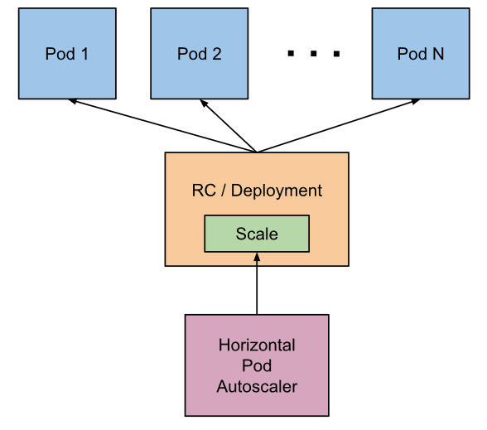
Autoscaling -Horizontal Pod Auto scaler

Slide 114
HPA Demo
$kubectl apply -f deployhpa.yml
$kubectl apply -f servicehpa.yml
$kubectl apply -f hpa.yml
$kubectl get hpa

Slide 115
How it works?
The HPA is implemented as a control loop, with a period controlled by the controller manager’s --horizontal-pod-autoscaler-sync-period flag (with a default value of 15 seconds).
During each period, the controller manager queries the resource utilization against the metrics specified in each HorizontalPodAutoscaler definition.
For per-pod resource metrics (like CPU), the controller fetches the metrics from the resource metrics API for each pod targeted by the HorizontalPodAutoscaler.
Then, if a target utilization value is set, the controller calculates the utilization value as a percentage of the equivalent resource request on the containers in each pod.
If a target raw value is set, the raw metric values are used directly. The controller then takes the mean of the utilization or the raw value (depending on the type of target specified) across all targeted pods, and produces a ratio used to scale the number of desired replicas

Slide 116
Exercise
Explore $Kubectl logs

